Slide 2
Hybrid Rice Hackathon
29th July, 2016
PRESENTED BY: NGILA KIMOTHO
MANAGING DIRECTOR
DRYLAND SEED LTD

Slide 3
“The power of investing in agriculture is clear: Agricultural development is two to four times more effective at reducing hunger and poverty than any other sector.” (BMGF, 2011)

Slide 4
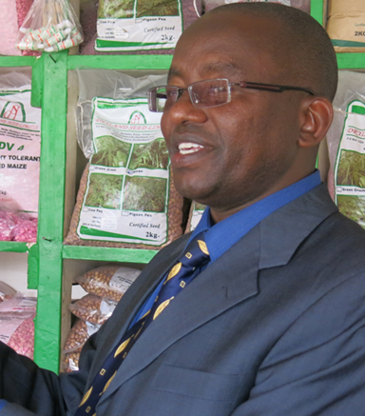
Founding DSL
Mr. Ngila Kimotho, founder of DSL, opened an agro-dealership in 2000, building upon 10 years of experience in the food industry.
Mr. Kimotho shifted to seed production responding to widespread food insecurity throughout East Africa, a problem that persists in 2016.

Slide 5
The DSL Business
DSL receives new seed varieties/germplasm from public research institutes including KALRO and CIMMYT.
Foundation seed is produced on a leased farm, and seed for sale is produced via contract by local farmers.
DSL cleans, treats, certifies, and packages seeds for distribution in its warehouse facility located in Machakos County (scheduled completion 2016).
DSL sales representatives market seeds to agro-dealers and farmers by conducting field days, growing demo plots, and creating relationships with buyers.
Seeds are sold in the retail store and by order, and distributed from the warehouse to the DSL retail store and agro-dealers.

Slide 6
The DSL Product Line
Crop Type | Varieties
Cereals Maize Sorghum Green Gram | KDV2, KDV4, SAWA, VIGA, DUS-CKH 11221*, VIGA Gadam, Seredo N26
Legumes Beans Pigeon Pea Cowpea | Kat B1, KatX56,Kat B9 Mbaazi 1, Kat 60/8 M66, K80
Vegetable Cabbage Cauliflower Onion Pepper Pakchoy Tomato Pumpkin | Indica F1, Poornima F1, Prema, Mekong F1, Mayleen F1, Kartik F1, Padma F1, Leela F1

Slide 7
Partners
Function | Organization
Research and Development | CIMMYT, KALRO, AATF, CIAT, ICRISAT, KEPHIS, East-West
Regulator | KEPHIS

Slide 8
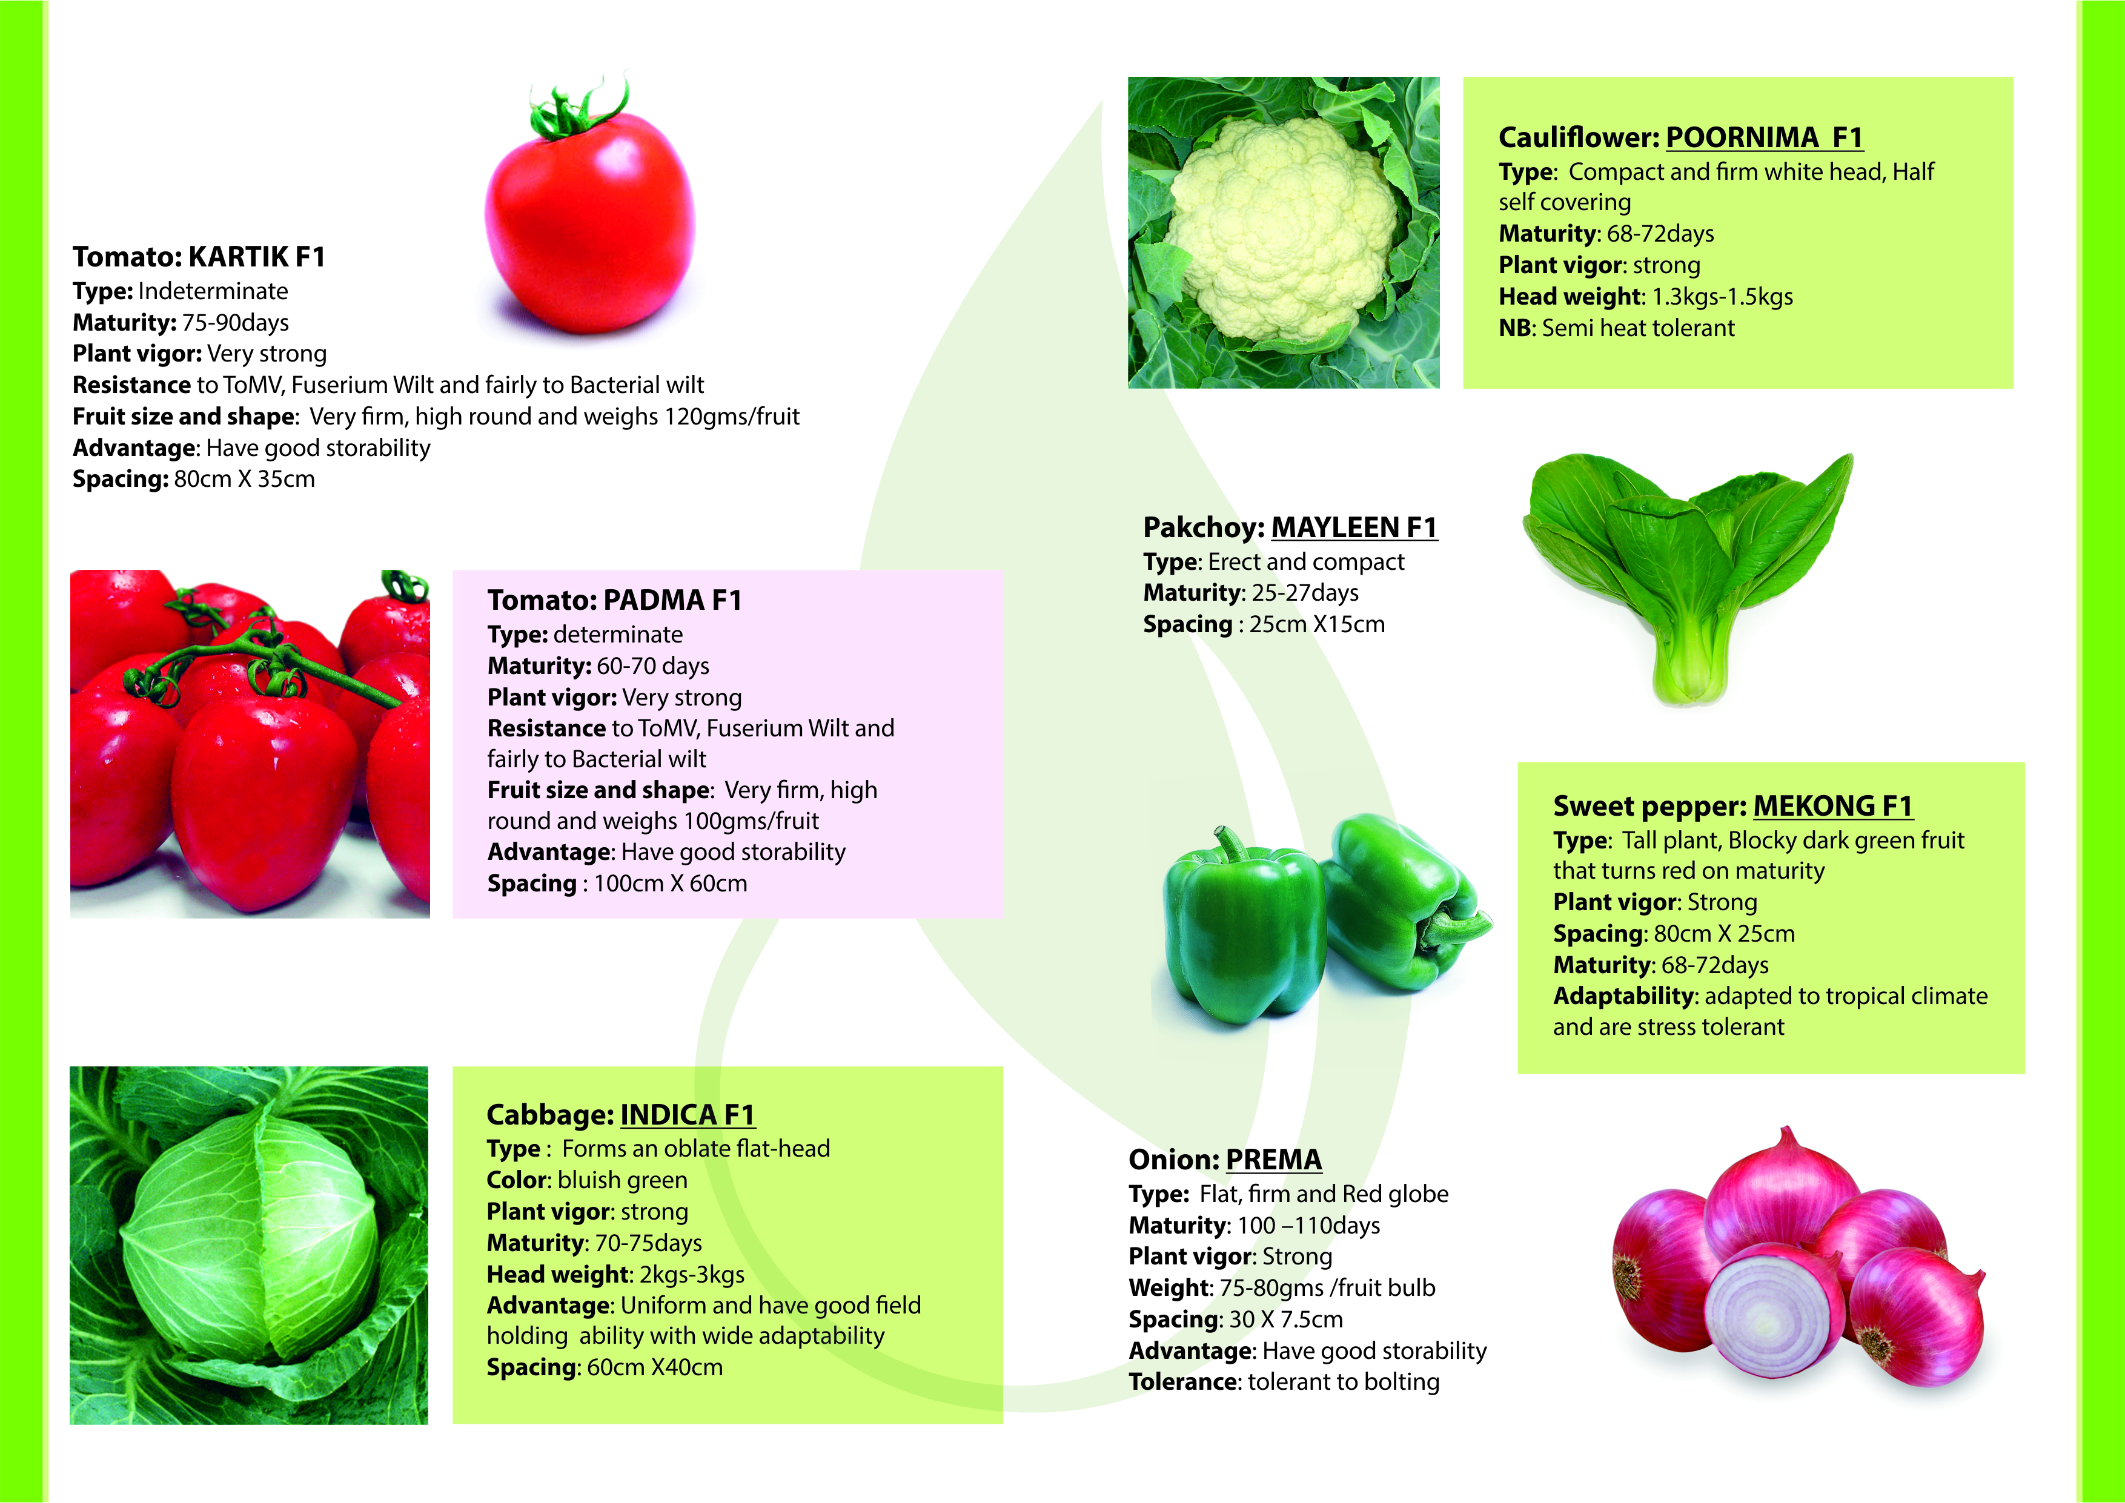
DSL Product Detail

Slide 9
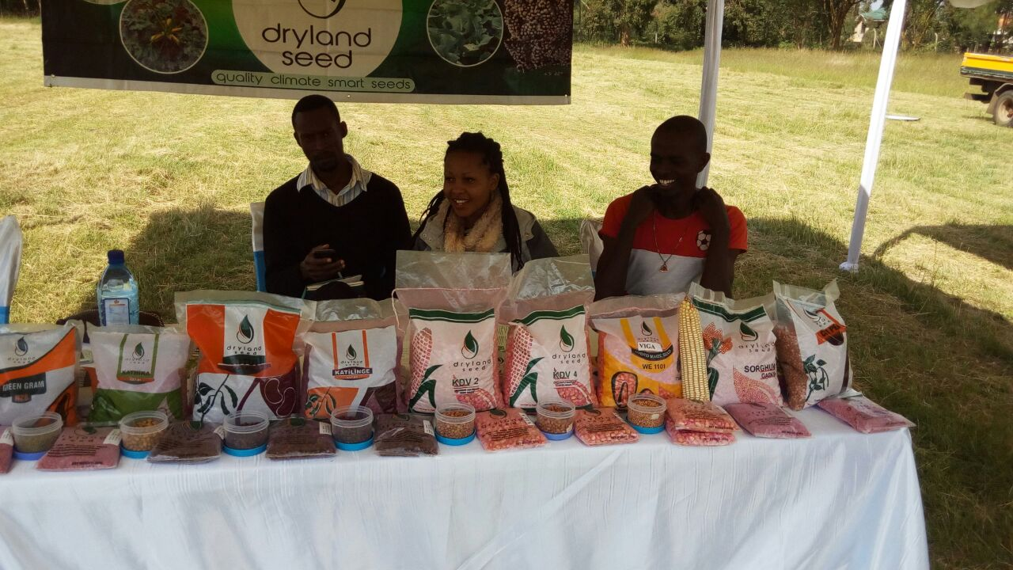
DSL Product Packaging

Slide 10
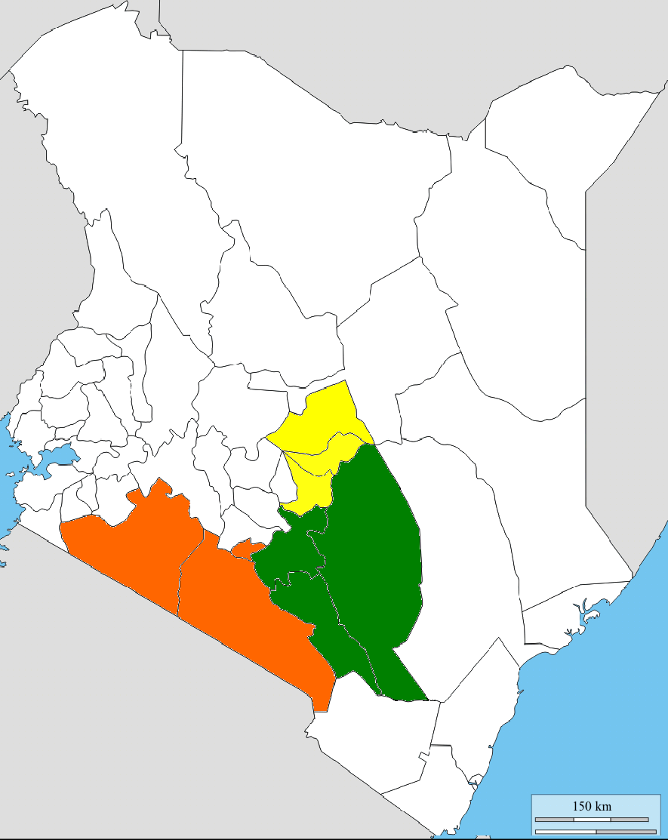
Where is DSL?
Northern Region: Meru, Tharaka-Nithi, Embu
Eastern Region: Machakos, Makueni, Kitui
Southern Region: Nairobi, Kajiado
Western region: Kisumu, Homabay
Riftvalley: Nakuru

Slide 11
Challenges
Low farmer adoption.
Erratic weather
Long business cycles
Access to our products by farmers
Unknown demand

Slide 12
How seed Industry can use technology
Educate and disseminate information
Purpose:
Empower farmers so that they can improve their yield by planting the right seeds for their geographical location and through sustainable agricultural methods.
Product marketing
Purpose:
Increase sales, improve distribution network, create brand awareness and promote brand loyalty.

Slide 13
Ctn..
Data collection, monitoring and evaluation
Purpose:
Determine the level of impact their seeds had in improving the farmers/outgrowers yield.
Identify markets which have stability in customer demand and also have good potential for market growth by identifying sales trend.
Seed company can give timely weather alerts to farmers.
Information will help the farmers adjust their crop production methods to changing seasonal patterns.
Climate data can enable seed co to plan ahead-crop/ variety.

Slide 14
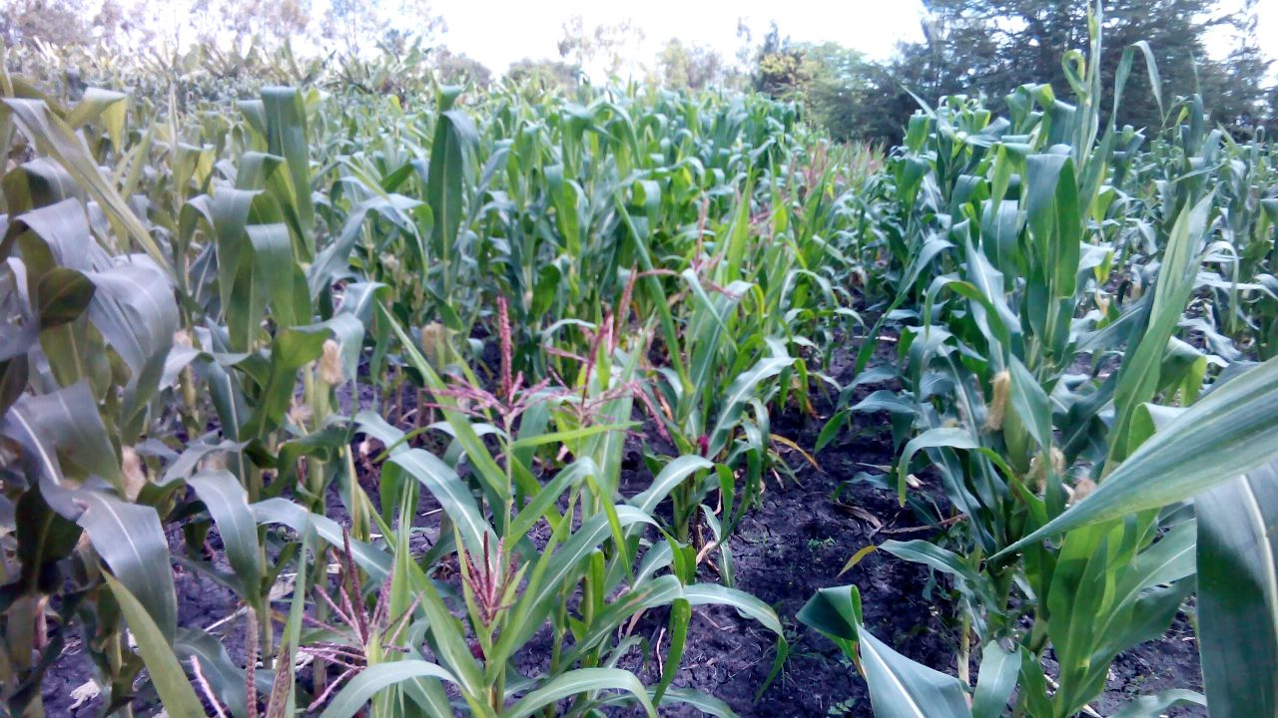
Parent production

Slide 15
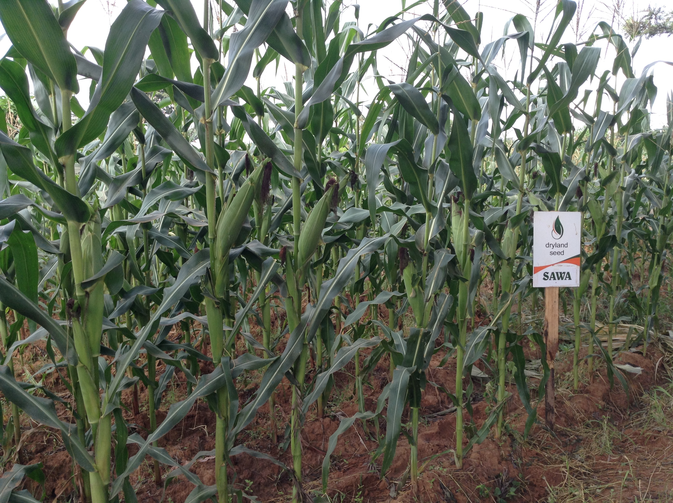
CHARA F1

Slide 16
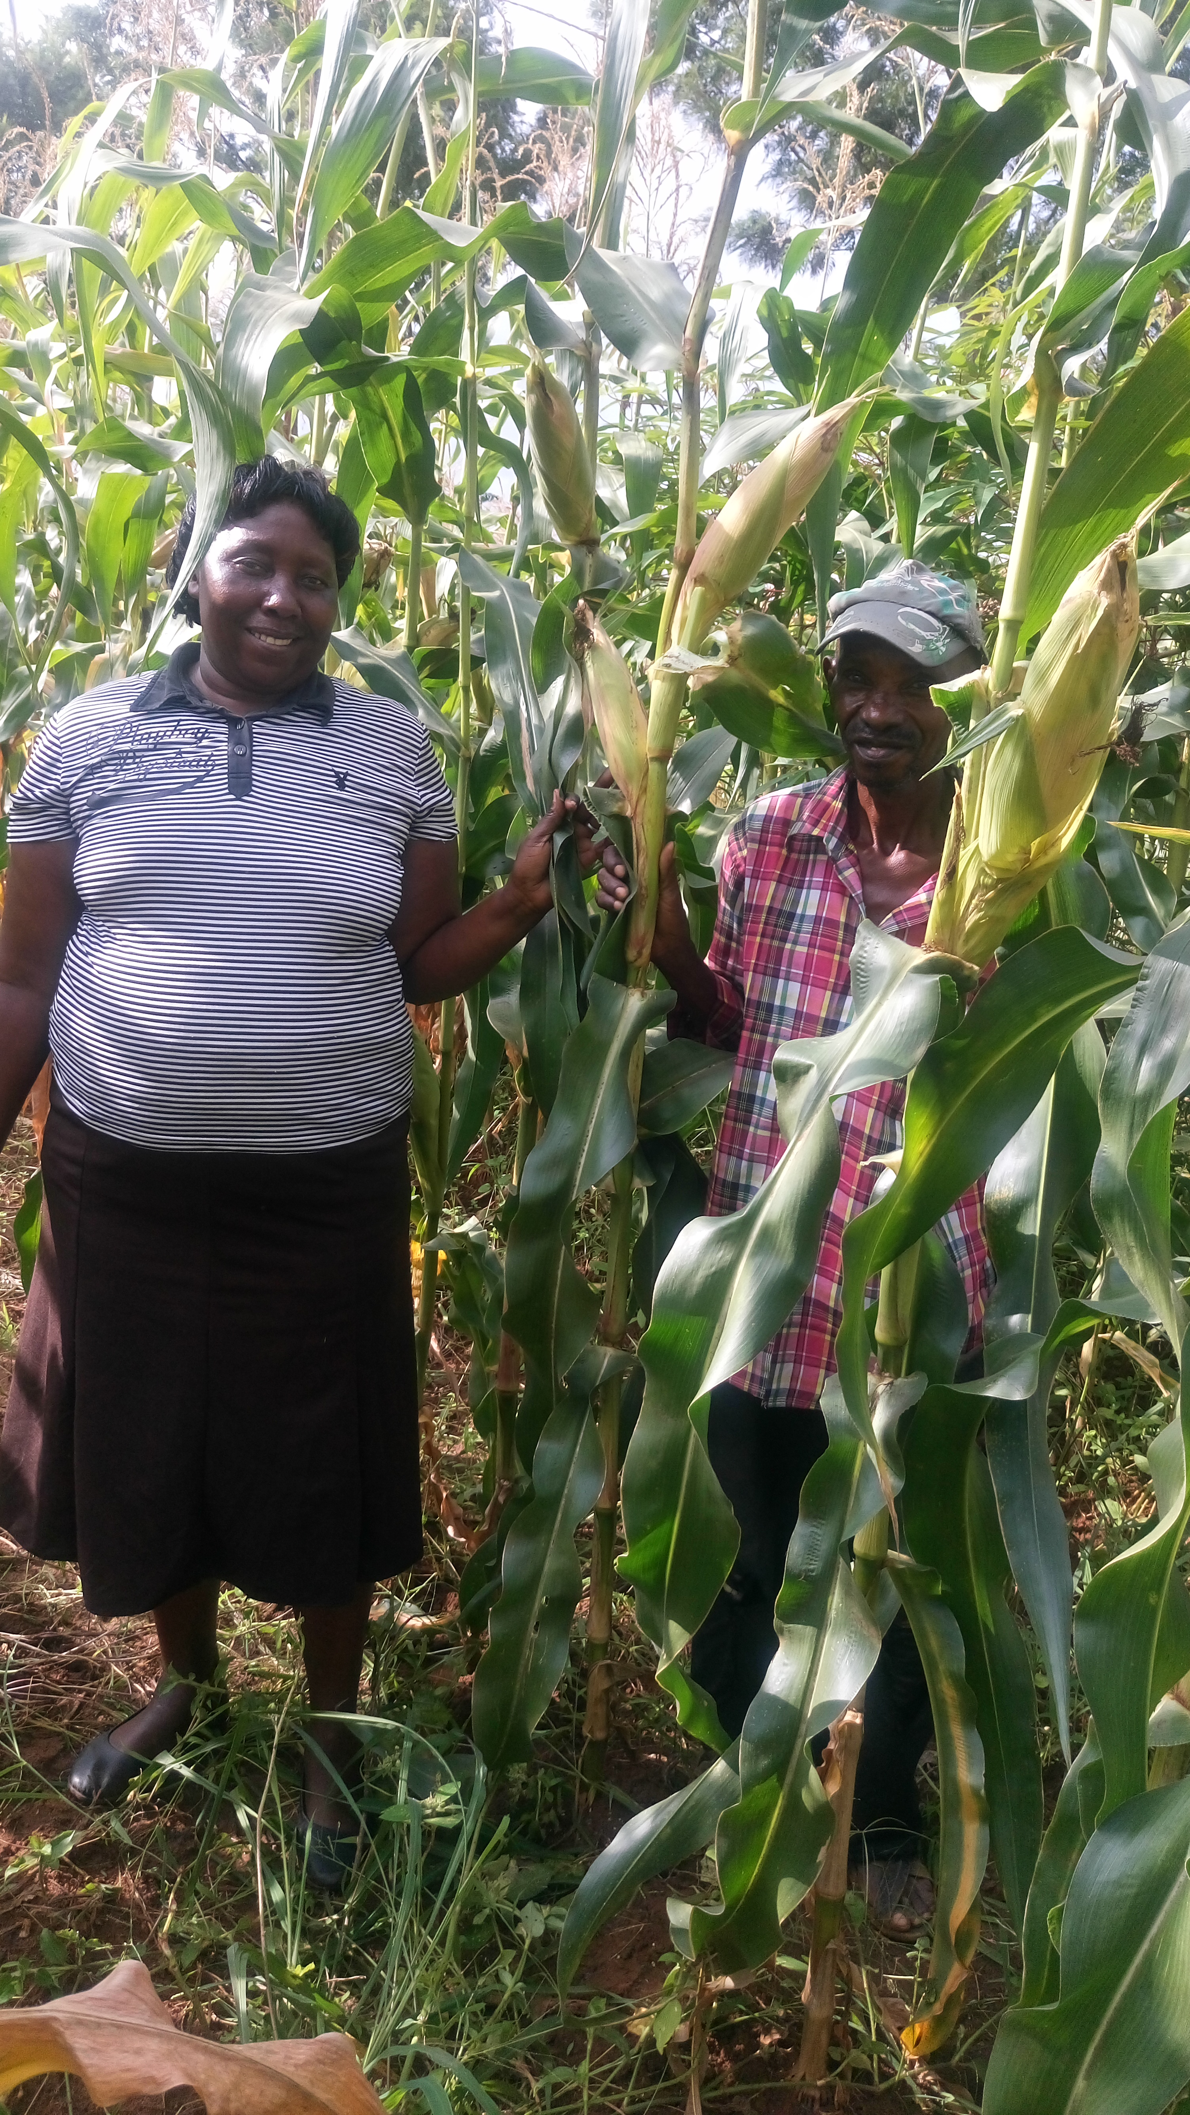
KDV 4, Makueni County

Slide 17
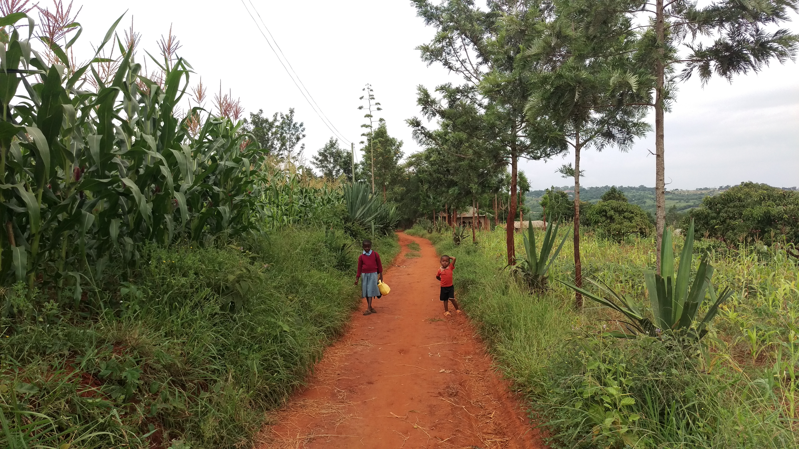
The DSL Difference
Non-certified Maize
DSL Maize
Farmer A
Farmer B

Slide 18
END
ASANTE SANA
THANKYOU

